Slide 1

Lab 2 : Complex Combinational Logic and Debugging : Hardware-based Data Encryption Standard (DES)
James E. Stine, Jr.
Edward Joullian Endowed Chair in Engineering
Oklahoma State University
Electrical and Computer Engineering Department
Stillwater, OK 74078 USA
james.stine@okstate.edu

Slide 2
Objective
Cryptography and especially hardware is an important element for the future.
Future engineers can gain fantastic jobs if they understand what security is and how it works.
I believe this laboratory will give you that opportunity and give you a fantastic opportunity to do great things!
You can do this!!! And you are the best!!!
Remember that I care about your success, and I want you to succeed – so do not feel abandoned and come see me if you need help!
I am here anytime but its easier if you get started early!
Repeated : do not wait to complete this lab as you will have a very hard time completing it if you wait.

Slide 3


Security is Cool
Everyone wants security!!!!!!!!!

Slide 4








Why?

Slide 5




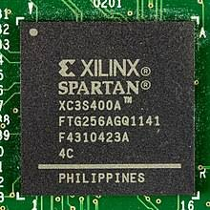

Cryptography in Hardware!!!

Slide 6



Cyber is a Great Career!
Some figures I have seen indicate that 75 million jobs and 47% of jobs are vulnerable to automation – security will be important for jobs!
The global blockchain market is estimated to grow from USD 3.0 billion in 2020 to USD 39.7 billion in 2025! [marketsandmarkets.com]
Security hardware makes sense as its fast and easy to deploy for any user.

Slide 7
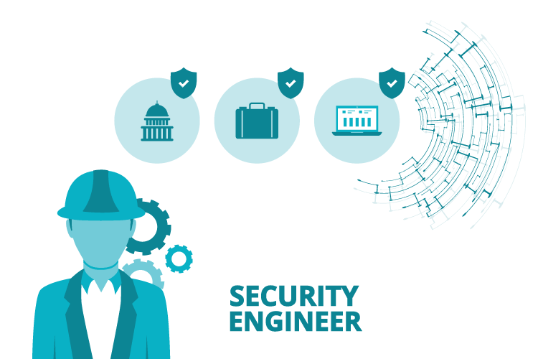

Slide 8
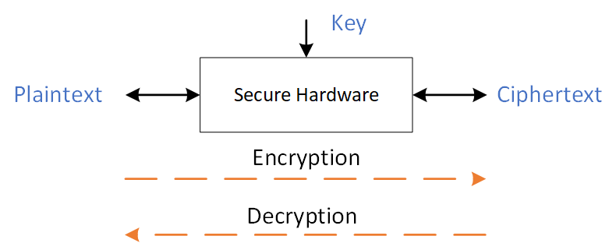
Cryptography
Cryptography is quite easy if you think about it as a password and access.
There are fancy diagrams available, but I made one that I think will help.

Slide 9
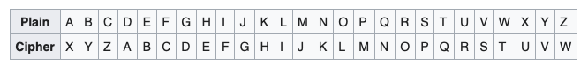
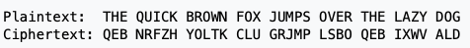
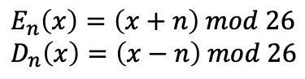
Caesar Cipher
https://en.wikipedia.org/wiki/Caesar_cipher
A Caesar cipher or shift cipher is one of the simplest and most widely known encryption techniques.
It is a type of substitution cipher in which each letter in the plaintext is replaced by a letter some fixed number of positions down the alphabet.
[Wikipedia]
$$E_{n}\left(x\right)=\left(x+n\right) mod 26 \\ D_{n}\left(x\right)=\left(x−n\right) mod 26$$
Cryptography is used to help hide messages from an adversary and has been used for a long time and shifting is key to most modern-day protection mechanisms.
Digital logic is now becoming a better way of securing messages as its faster, more efficient and secure.

Slide 10
DES
The Data Encryption Standard or DES is a symmetric-key algorithm for encryption of data.
The key length is 56 bits and is an early form for security in hardware as it was straightforward and easy to use.
Unfortunately, the relatively short key size made it easy to break so its no longer used (it was cracked in 1999 via brute force in less than 24 hours).
But the basics of DES are still used in something called AES that is commonly used today.
DES was invented in the 1970s for IBM based on earlier designs by Horst Feistel.
The algorithm was later submitted to the National Security Agency (NSA) for use and standardized by the Federal Information Processing Standard (FIPS) in 1977.
Triple DES or (3DES) is still used today in some applications.
Despite DES losing the lofty position of being the go-to data encryption standard algorithm, it is still worth learning.

Slide 11
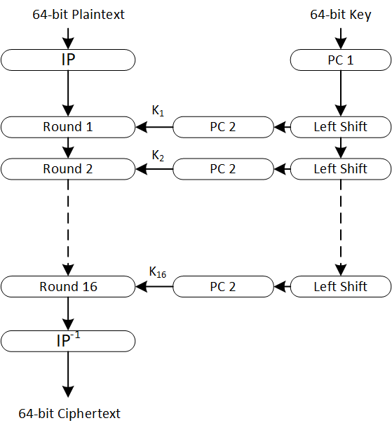
Data Encryption Standard (DES)
DES has 16 rounds denoted by the Feistel block
It uses 16 generated SubKeys that are produced from the center block
The architecture uses symmetric-key encryption in that it can be encrypted or decrypted based on its direction.
It has two main blocks : DES block and SubKey generation.
DES Rounds
SubKey

Slide 12
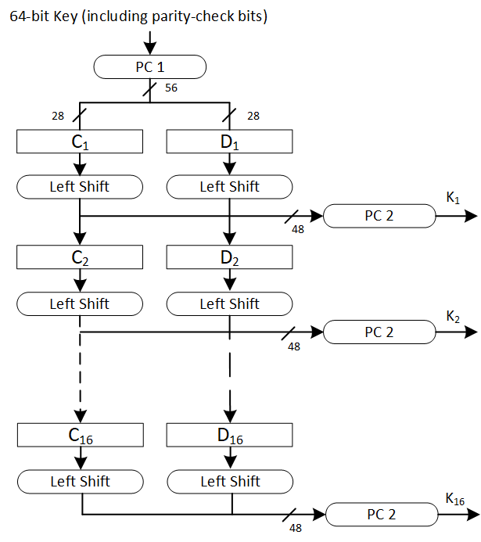
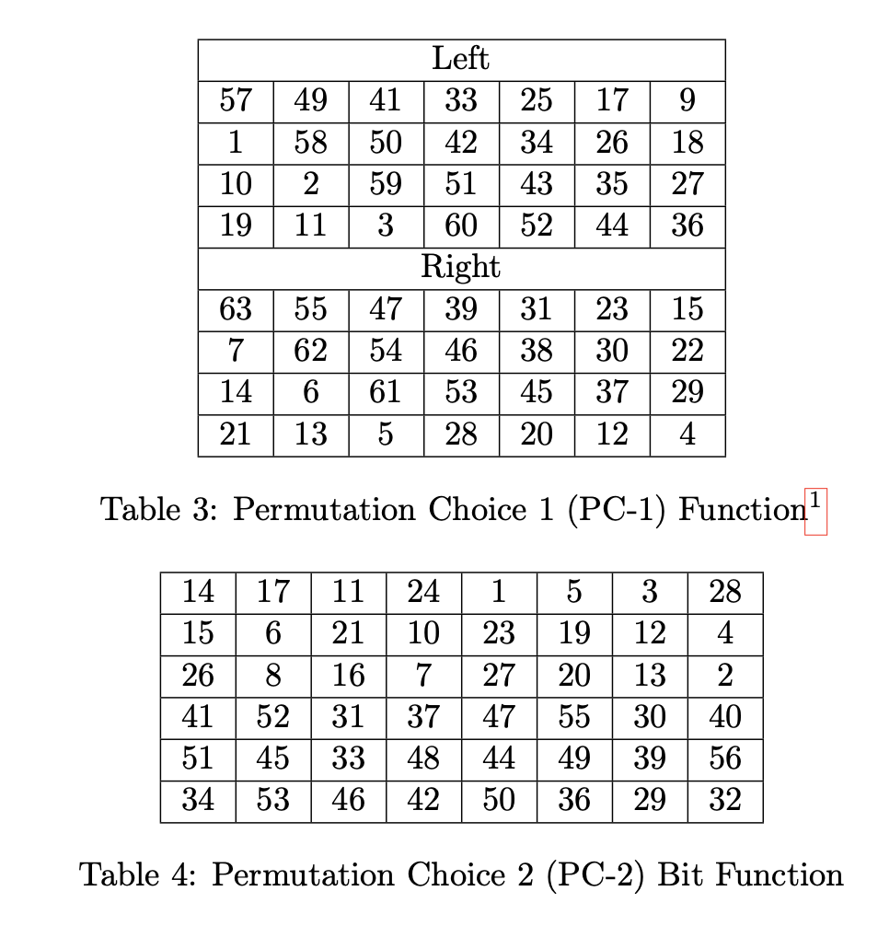
SubKey Generation
Permutation Blocks
…more detail in Lab 2 document

Slide 13
SubKey Generation
Key generation is the easiest portion of DES
It basically does two items : Permutations and Rotation,
PXX is sometimes called a permutation or switching of order
Rotation?
A rotation is the same as a shift but specialized (sometimes called circular shift)
The rotation works on two separate groups of 32-bits (i.e., breaks the 64-bits into two segments of 32-bits each).
It also has left circular shifts by 1 or 2 based on the round.
Iter # | 1 | 2 | 3 | 4 | 5 | 6 | 7 | 8 | 9 | 10 | 11 | 12 | 13 | 14 | 15 | 16
Left Shift | 1 | 1 | 2 | 2 | 2 | 2 | 2 | 2 | 1 | 2 | 2 | 2 | 2 | 2 | 2 | 1

Slide 14
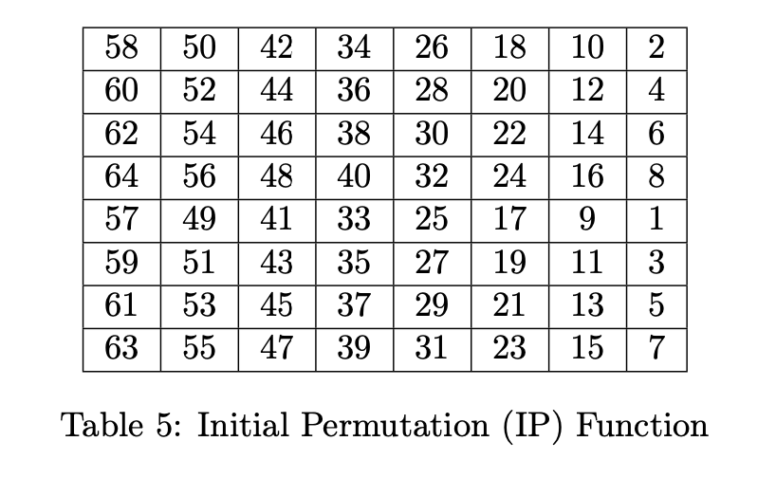
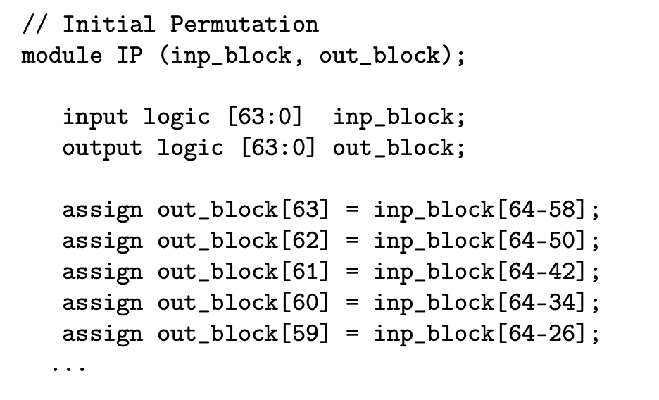
Be careful: Positions by Security Engineers
Security is still an ongoing area and there are many who are in this area: mathematicians, engineers, computer scientists, physicists, …
I personally feel Electrical and Computer Engineering people understand the issue on where positions happen, but many who are not part of our community seem to not understand yet.
I have given you an example to help by showing the IP (Initial Permutation) and IP⁻¹ (Final Permutation) stages update the position (please follow along).

Slide 15

Bit Swizzling in SystemVerilog (SV)
Rotation in SV is easier with bit swizzling
Bit swizzling has two functions in SV
Concatenation (putting two vectors together)
Replication (repeating items within a vector or bit)
It is probably one of the coolest and best features of SV!
It is often under utilized – use in this lab!!!
It will save you an enormous amount of time!
assign y = {a[2:1], {3{b[0]}}, a[0], 6'b100_010};
// if y is a 12-bit signal, the above statement produces:
y = a[2] a[1] b[0] b[0] b[0] a[0] 1 0 0 0 1 0
// underscores (_) are used for formatting only to make
// it easier to read. SystemVerilog ignores them.

Slide 16
Rotation by 1 or 2
Rotations are just circular shifts where anything that is shifted gets placed back in the registers.
Use assign statements in SV to help with bit swizzling; however, its only 1 or 2 based on round.
Good calculator available : https://onlinetoolz.net/bitshift#base=16&value=B8&bits=8&steps=2&dir=l&type=circ&allsteps=1
A | A[7] | A[6] | A[5] | A[4] | A[3] | A[2] | A[1] | A[0]
0xB8 | 1 | 0 | 1 | 1 | 1 | 0 | 0 | 0
B | A[7] | A[6] | A[5] | A[4] | A[3] | A[2] | A[1] | A[0]
0x71 | 0 | 1 | 1 | 1 | 0 | 0 | 0 | 1
8-bit Example
ROL1
C | A[7] | A[6] | A[5] | A[4] | A[3] | A[2] | A[1] | A[0]
0xE2 | 1 | 1 | 1 | 0 | 0 | 0 | 1 | 0
ROL2
assign C = {A[5:0}, A[7:6]}

Slide 17
56-bit Key!
Your DES key is is 56-bits with 8-bits of parity.
Error detection is an important part consideration of data transmission
Parity checking
Redundancy checking
Parity involves performing a basic calculation of the number of digital 0’s and 1’s making up a transmission unit
Parity calculated on even or odd number of 1’s but for DES it is odd parity.
Example: 1010_101 → 1010_1011
Parity bit is set per frame (byte or character)
Parity checking is found mostly in Asynchronous communication
The parity within the key is computed simply by XOR’ing of the previous 7 bits.

Slide 18
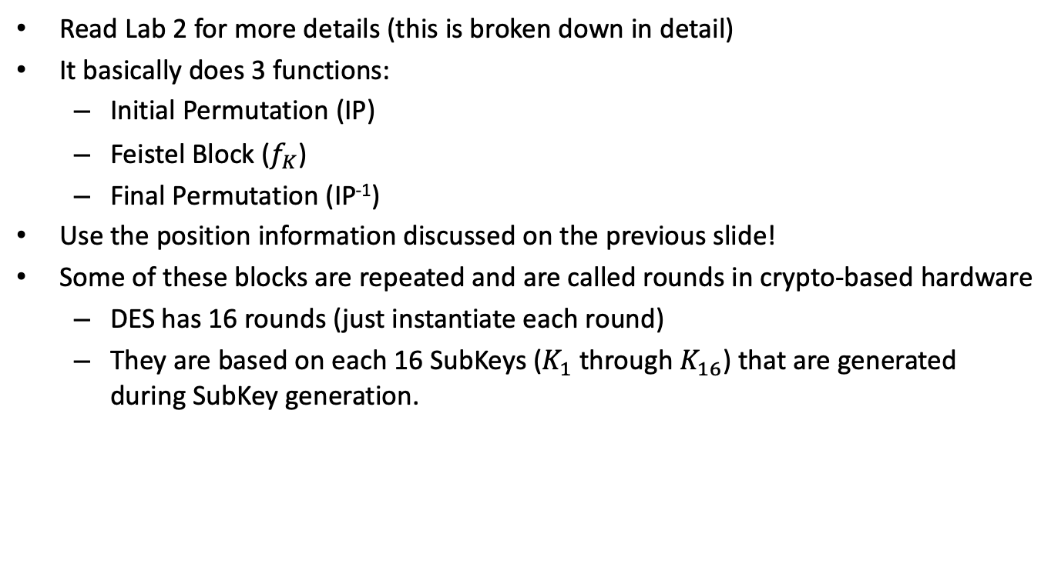
Encrypt/Decrypt Breakdown
Read Lab 2 for more details (this is broken down in detail)
It basically does 3 functions:
Initial Permutation (IP)
Feistel Block ($f_{K}$)
Final Permutation (IP⁻¹)
Use the position information discussed on the previous slide!
Some of these blocks are repeated and are called rounds in crypto-based hardware
DES has 16 rounds (just instantiate each round)
They are based on each 16 SubKeys ($K_{1}$ through $K_{16}$) that are generated during SubKey generation.

Slide 19
Feistel Block
The key generation is easiest and probably should be done first to make sure its working.
The main part of the encryption and decryption is done based on something called the Feistel block.
This block was introduced by Horst Feistel at IBM in his earlier work on cryptography and its an important part of many cryptography algorithms.
It is important to understand that I am not asking you to understand how each block works – just implement it.
There are some great books and websites that can help you understand more about cryptography for those that are interested.
See the references on Canvas as well as on the Lab 2 document for more information.

Slide 20
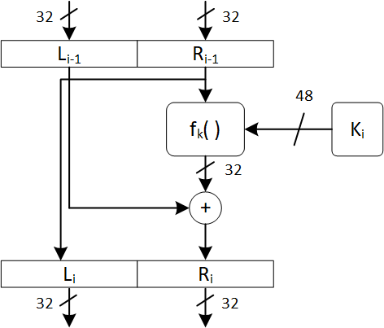
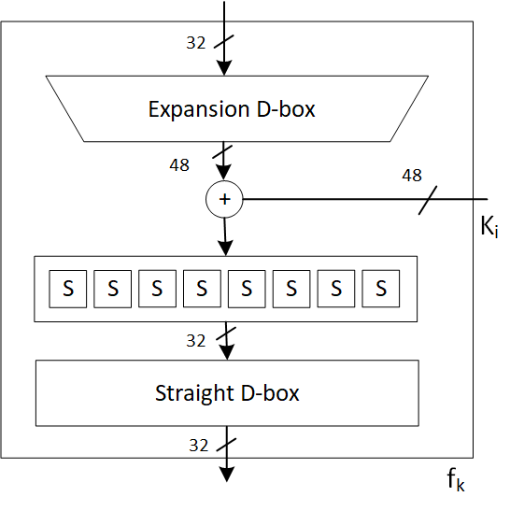

Feistel Block ($f_{K}$)
Most cryptography-based algorithms use rotation and exclusive OR (XOR) to help with modular arithmetic
The Feistel Block uses something called S-boxes and Permutations (EP and SF)
DES uses permutations that are called substitutions
These are called substitution boxes and basically are matrices that allow the symmetric-key algorithms to perform substitution.
Some S-boxes are generated dynamically – ours are just tables that are looked up.
Use the provided stubbed SV (des_stub.sv) to help you get started.
https://en.wikipedia.org/wiki/Method_stub

Slide 21
S-box Implementation
Again, I give you each of the eight S-boxes.
You should split 48 bits of input into each S-box (i.e., 6-bits) each.
Each S-box outputs 4-bits as an output for a total of 32 bits
logic [47:0] sbox_pre;
assign sb8in = sbox_pre[5:0];
assign sb7in = sbox_pre[11:6];
assign sb6in = sbox_pre[17:12];
assign sb5in = sbox_pre[23:18];
assign sb4in = sbox_pre[29:24];
assign sb3in = sbox_pre[35:30];
assign sb2in = sbox_pre[41:36];
assign sb1in = sbox_pre[47:42];

Slide 22
Implementation
You will implement DES in SystemVerilog.
All blocks are done with combinational logic *only*.
Verification will be discussed shortly but use your testbenches from Lab0 and Lab1 to help you with the testing!
I have also given you another testbench that actually reads values from a file with 4 sample keys, plaintext, and ciphertext.
There’s also a small Java program (genDESkey.java) I wrote that generates random keys with parity in case anyone needs some to test.
You should have an input that indicates either encryption or decryption!
After you get your design working, please implement on the DSDB board and use the 7-segment display to display the plaintext and ciphertext and verify it is working correctly.

Slide 23
7-segment Display
Uh-oh!
You only have four (4) 7-segment displays, but you have 64-bits of key, plaintext, and ciphertext.
You will have to figure a way to display that on the four 7-segment displays.
It is not hard if you think about it a little but use the switches and push buttons to help you with this.
You should also display on the LEDs if odd parity is not correct on the 64-bit key.

Slide 24
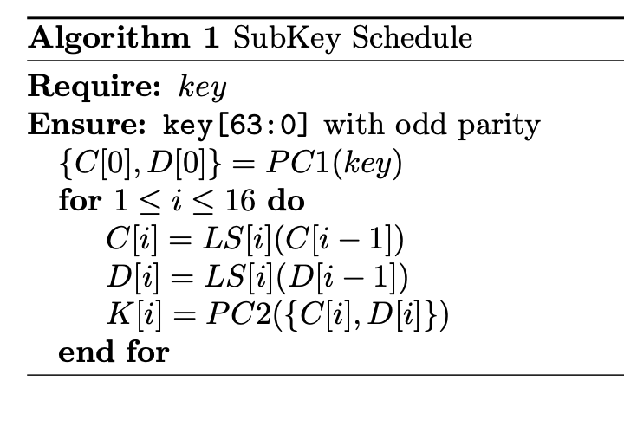
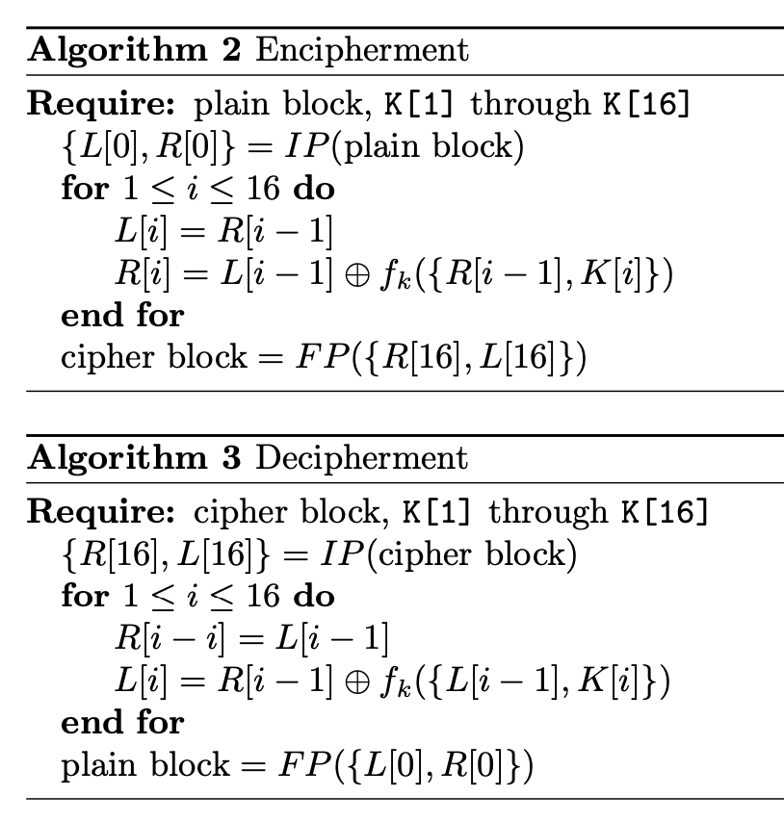
Summary of DES
Encryption or Decryption is done with the same block because it is a symmetric algorithm.
The only difference is the order of keys!
K1 through K16 for encryption or K16 through 1 for decryption.

Slide 25
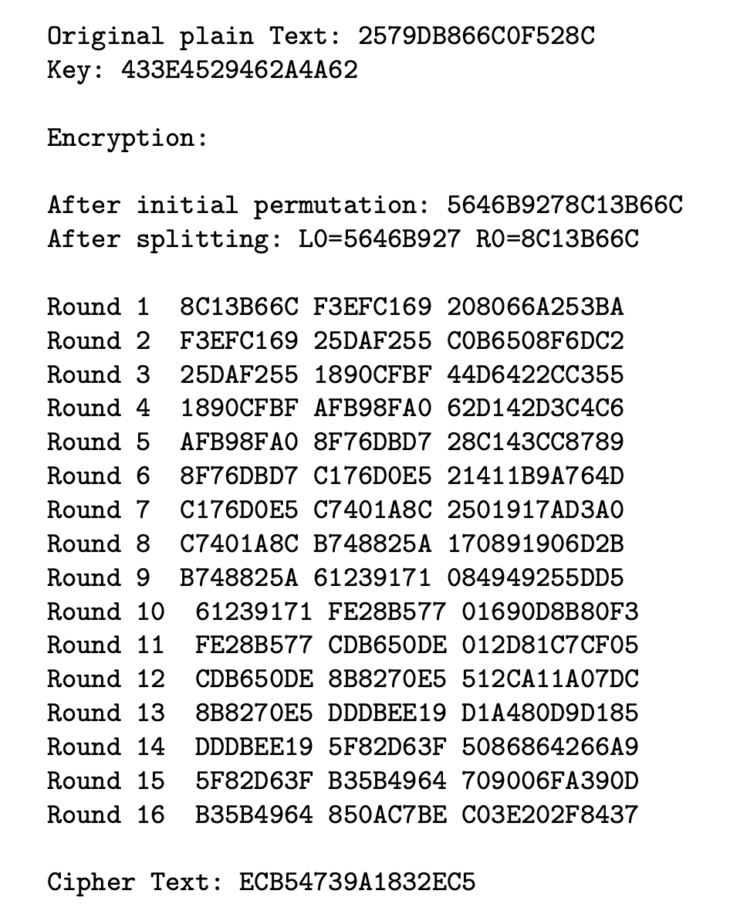
Verification
Verification is key to digital systems and especially digital logic.
Remember that verification is the process of seeing something backwards in the flow (e.g., Is my output the correct output from this block?)
To help with verification we will use a Java program I developed (DES.java).
You can use the Java program to help you with each block and what each output should be based on whether you are performing encryption or decryption
I made a Makefile that you can use to compile the tool and use it.
Please install Java JDK if you want to run on your laptop or desktop (It should be installed in ENDV 360)

Slide 26
Extra Credit
Today, employers want to see what you did during your undergraduate degree in terms of topics and assignments.
Document your labs, including something like this one, to impress future employers as it will help you get coveted jobs and internships.
The lab we are doing this week is not easy and people will be impressed.
However, caveat emptor (buyer beware) – no one wants to hear you didn’t do anything impressive in engineering school.
Impress people with added features.
Build a website (check out github.io) – its free and easy!
Build a video showing what you did!

Slide 27

Last-minute Items
This lab is straightforward if you start on time
Much of the detail is stubbed out in the des_stub.sv and comments are included indicating where things go including some freebies.
It is just simple instantiation and implementation (and, of course, verification).
This is a 3-week lab so start early!
There are others who have tried to implement DES on the Internet – most of them are wrong or difficult to implement (don’t waste your time copying – it could get you in trouble!)
Believe in yourself!!
I believe in you and your abilities!
Enjoy the opportunity!

